Slide 1

Water Tank Level Management using ESP32 and Ultrasonic Sensor
This innovative system leverages the power of the ESP32 microcontroller and an ultrasonic sensor to precisely monitor and manage water tank levels, ensuring efficient and sustainable water usage.

Slide 2

Introduction to the Problem and Importance of Water Conservation
1
Water Scarcity
2
Environmental Impact
Many regions face critical water shortages, necessitating proactive management of this valuable resource.
Inefficient water usage can lead to ecological damage and depletion of groundwater reserves.
3
Cost Savings
Effective water conservation measures can significantly reduce utility bills and operational costs.

Slide 3
Overview of the ESP32 Microcontroller and Ultrasonic Sensor
ESP32 Microcontroller
Ultrasonic Sensor
Integration
A powerful, low-power, and Wi-Fi-enabled microcontroller ideal for IoT applications.
A non-contact distance measurement device that can accurately detect water levels.
The ESP32 and ultrasonic sensor work together to create a comprehensive water tank monitoring system.

Slide 4
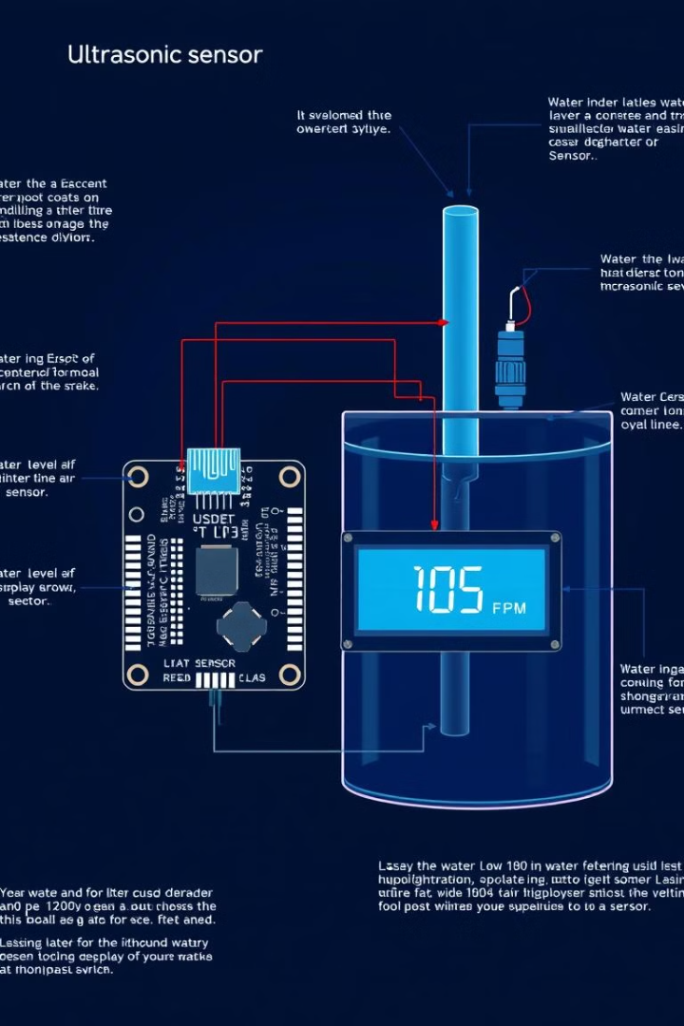



Sensor Integration and Data Collection Mechanism
Sensor Placement
The ultrasonic sensor is positioned to measure the water level in the tank.
Data Acquisition
The ESP32 microcontroller collects real-time water level data from the sensor.
Data Processing
The ESP32 processes the sensor data and prepares it for further actions.

Slide 5
Mobile App Development for Remote Monitoring and Control
Intuitive Interface
Remote Access
Customizable Alerts
The mobile app provides a user-friendly dashboard to view real-time water levels.
Users can monitor and control the water tank from anywhere, using their mobile devices.
The app allows users to set personalized notifications for low or high water levels.

Slide 6

Water Level Monitoring and Automated Tank Filling
1
Level Monitoring
The ESP32 continuously monitors the water level using the ultrasonic sensor.
2
Automated Filling
When the level drops below a set threshold, the system triggers an automated filling process.
3
Precision Control
The system ensures the tank is filled to the optimal level, preventing waste or overflow.

Slide 7
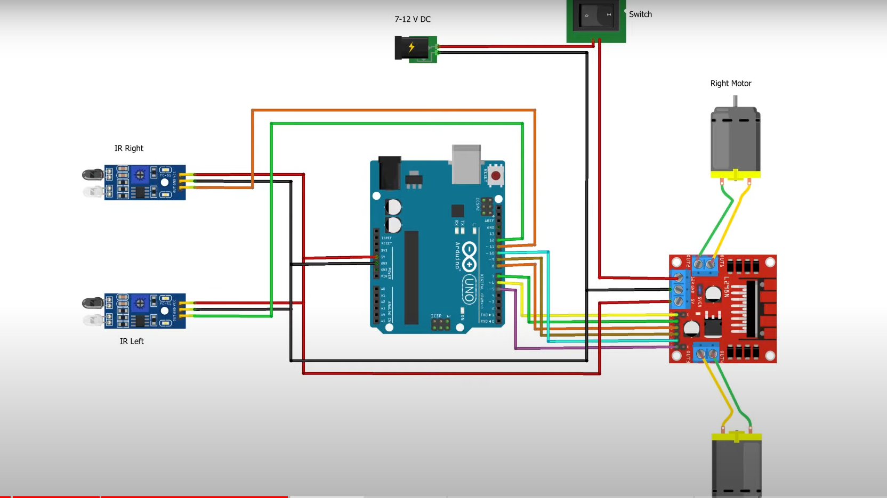
CIRCUIT DIAGRAM

Slide 8




Notifications and Alerts for Efficient Water Usage
Low Level Alert
High Level Alert
Usage Analysis
Users receive real-time notifications when the water level drops below a critical threshold.
The system triggers alerts to prevent tank overflow and water wastage.
The app provides detailed water usage data to help users optimize their consumption.

Slide 9
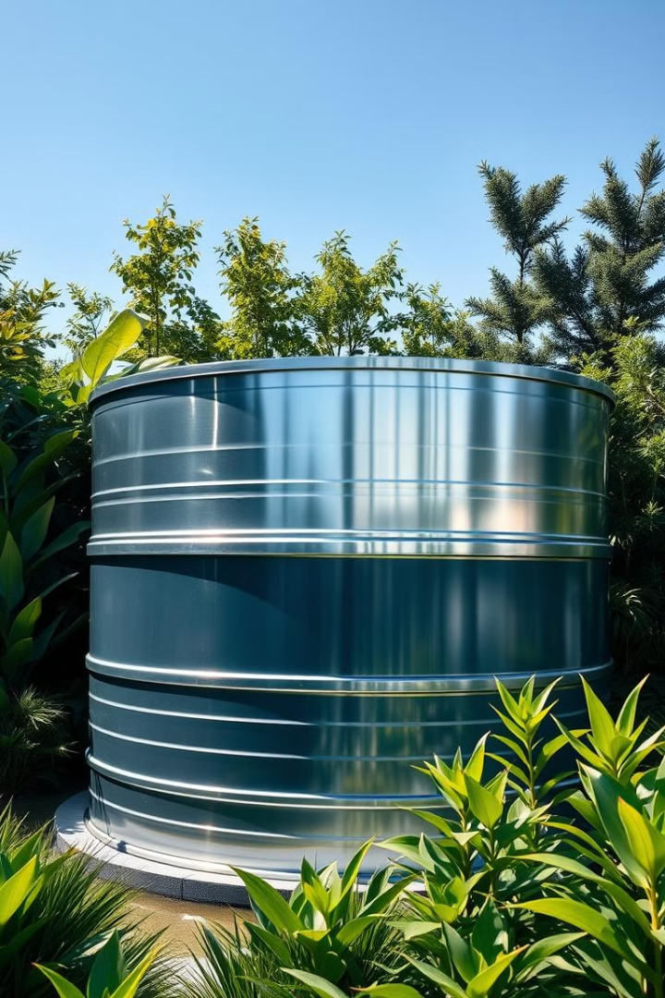
Conclusion and Future Improvements
Sustainable Solution
Scalable Design
This system helps conserve water, reduce costs, and minimize the environmental impact.
The modular architecture allows for easy integration with existing water infrastructure.
Future Enhancements
Incorporating machine learning for predictive analytics and automated decision-making.

Slide 10
THANK YOU

